Slide 1
Data Science Shark Tank
Branden Diniz, Xuanyu Li, Dennis Silva, Chuxin Wei

Slide 2
Online Travel Agency(OTA)
Travel Products and Services
Parent company of several global online travel brands
Purchased Travelocity for $280 million last year
Recently purchased Orbitz Worldwide for $1.33 billion
Main Competitor: Priceline Group

Slide 3
Business Problem
Better understand consumer demand
Provide customers with the best service recommendations
Our Solution
Created an algorithm that can generate predictions based on the likelihood a customer will stay in one of one-hundred different hotel groups

Slide 4
Motivation
Thousands of hotels to choose from every destination
A hotel is the hub for any vacation
Expedia’s acquisition brings hundreds of thousands of new users, which means more data for analysis.
This is the time to understand Expedia’s target market and enhance customer loyalty!

Slide 5
Data Preparation
4 files (sample_submission.csv, destinations.csv, test.csv, and train.csv )
test.csv and train.csv: contain the logs of customer behavior for each user event transactions
Attributes: Hotel_cluster
destinations.csv:
Attributes: srch_destination_id, d1-d149
Notes:
srch_destination_id: ID of the destination where the hotel search was performed
d1-d149: latent description of search regions

Slide 6
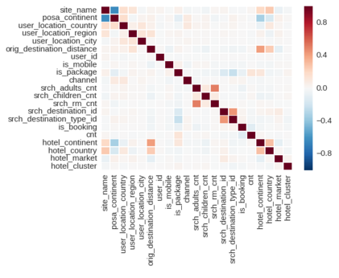
Basic Data Analysis
Correlations between different features within each customer behavior log
Results:
hotel_continent’ has a positive correlation to ‘orig_destination_distance’
‘hotel_continent’ has a negative correlation to ‘posa_continent’
Conclusion:
Individuals that tend to book on Expedia are going to hotels farther away from their home continent
Notes:
hotel_continent’ (the continent the hotel is located on)
‘orig_destination_distance’ (physical distance between a hotel and customer at time of search)
‘posa_continent’ (the continent where the booking was done)

Slide 7
Data Analysis---Algorithm
Classifier: Random Forest Classifier
One of the best among classification algorithms
High dimensional spaces
Large number of training examples
Better randomness
Minimize overfitting

Slide 8
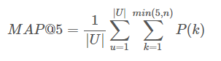
Evaluation
Evaluator: Mean Average Precision of 5 (MAP@5)

Slide 9
Machine Learning Process
Code: Reference demo called “Random forest -low-memory” on the public Kaggle forums
Data Processing: (1)Converted the customer logs into a Pandas data frame
and
(2)Preprocessed the data by filling in missing feature values and removing NaNs
Sampling: Split the training.csv file into yet another training/testing subset of 66% to 33% split respectively.
Produce Probabilities: By using Random Forest Classifier
Evaluation: By using MAP@5
File Submission

Slide 10
Result
MAP@5 Score
DSTeam: 0.12321
Most Frequent Benchmark: 0.05949
Sample Submission Benchmark: 0.01744
Random Guess Benchmark: 0.02260
Top Scorer: 0.49311

Slide 11
THANK YOU

